Slide 1
ATTRIBUTE-ORIENTED INDUCTION IN RELATIONAL DATABASES by Yandong Cai
Presented by
P. Krishna Reddy
IIIT Hyderabad
Reference 1: Jiawei Han, Yandong Cai, Nick Cercone: Knowledge Discovery in Databases: An Attribute-Oriented Approach. VLDB 1992: 547-559
Reference 2: Attribute Oriented Induction in Relational Databases, MS thesis, 1989,
Simon Fraser University, https://summit.sfu.ca/item/4542

Slide 2
Outline
Introduction
Learning from examples
Concepts of learning from databases
Attribute oriented induction in relational databases
Variations of the learning algorithms
Discussion
Implementation and experiments
Conclusions and future research

Slide 3
Introduction
It is advantageous to learn characteristics of data in relational databases.
By learning from databases, knowledge rules can be extracted from the large amount of data and interesting relationships among data can be discovered automatically.
Relational databases store a large amount of information in a structured and organized manner.
Each tuple in the database can be viewed as a typed logical formula in the conjunctive normal form.
Such uniformity facilitates the application of well developed database implementation techniques and the development of efficient learning algorithms in large databases

Slide 4
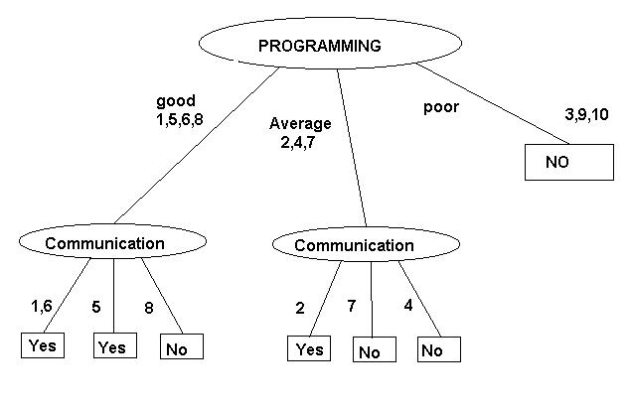
Paradigm: Learning from Examples
The paradigm of “learning from examples”
Learning by generalizing specific facts or observations has been adopted in many existing induction learning algorithms
Example: A recruitment agency which specialises in recruiting trainee programmers wants to develop a decision tree to filter out unsuitable applicants.
The agency we three criteria to make this decision: programming ability(Prog.), communication ability*Com.) & presentation(Pres.). Suppose the Agency provide the examples in the following Table:
NO | Prog. | Com | Pres | Decision
1. | good | ok | neat | yes
2. | average | ok | fair | yes
3. | poor | liar | scruffy | no
4. | average | liar | fair | no
5. | good | boring | scruffy | yes
6. | good | ok | scruffy | yes
7. | average | boring | scruffy | no
8. | good | liar | scruffy | no
9. | poor | boring | fair | no
10. | poor | boring | scruffy | no

Slide 5
Motivation
The facts (large) in the database can be viewed as examples for learning.
The paradigm “learning from examples” should be a strategy for learning
However, (limitations)
Current learning systems do not integrate well with relational database systems
Due to large number of possible combinations in such testing, the tuple-oriented approach is quite inefficient to perform learning from large databases
For example, if there are 100 training examples (tuples), each tuple has 5 attributes, and each attribute value can be one of the three concepts on three different generalization levels, such coverage testing will be invoked up to 100 * (5*5*5) = 12500 times in the worst case.
Moreover, most existing algorithms do not take the features and implementation techniques provided by database systems
They do not have negative examples

Slide 6
Introduction
Following the learning from examples paradigm, the proposed attribute-oriented concept tree ascending technique, integrates database operations with the learning process.
There are two types of knowledge rules
characteristic rules and classification rules
Two algorithms are proposed
LCHR algorithm for Learning CHaracteristic Rules
LCLR algorithm for Learning CLassification Rules.
These two algorithms can learn both conjunctive rules and restricted forms of disjunctive rules, and learning can be performed with databases containing exceptions and noisy data using database statistics.
The algorithms show that attribute-oriented induction substantially reduces the complexity of the database learning processes

Slide 7
Outline
Introduction
Learning from examples (Related Work)
Concepts of learning from databases
Attribute oriented induction in relational databases
Variations of the learning algorithms
Discussion
Implementation and experiments
Conclusions and future research

Slide 8
Learning from Examples: An AI approach
Learning from examples can be viewed as a reasoning process from specific instances to general concepts.
Learning from examples can be characterized by a tuple <P, N, C, A>, [GeN87]
where P is a set of positive examples of a concept,
N is a set of negative examples of a concept,
C is the conceptual bias which consists of a set of concepts to be used in defining learning rules and results,
and A is the logical bias which captures particular logic forms

Slide 9
Approach 1 [Mic83]:
The training examples are classified in advance by the teacher into two disjoint sets, the positive example set and the negative example set. The learning task is to generalize these low-level concepts to general rules.
Approach 2 [GeN87]:
There could be numerous inductive conclusions derived fiom a set of training examples. For instance, the concept "red" can be generalized in several ways: "red or black", "dark color", "warm color", etc.
To cope with this multiplicity of possibilities, it is necessary to use some additional information, problem background knowledge, to constrain the space of possible inductive conclusions and locate the most desired one(s).
The conceptual bias and the logical bias provide the desired concepts and logic forms which serve as this kind of background knowledge.
These biases restrict the candidates to formulas with a particular vocabulary and logic forms. Only those concepts which can be written in terms of this fixed vocabulary and logic forms are considered in the learning process.

Slide 10
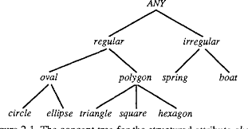
Depending on the structure of the attribute domains, we can distinguish among three basic types of attributes [Mic83]:
Nominal attributes:
Consists of independent symbols or names
No structure is assumed to relate the values in the domain.
Example: computer ID
Numeric attributes:
The value set of such attributes is a totally odered set. For example, weight, salary and gpa are numeric attributes.
Structured attributes:
The value set of such attributes has a tree structure which forms a generalization hierarchy.
A parent node in such a structure represents a more general concept than the concepts represented by its children nodes.
The domain of structured attributes is defined by the problem background knowledge.
For example, the attribute shape could be a structured attribute whose domain is a tree structure with a set of leaves:
{triangle, circle, ellipse, hexagon, square, boat, spring), and
the non-leaf nodes are defined by rules: {circle, ellipse) c oval {triangle, square, hexagon) c polygon {oval, polygon] c regular {spring, boat) c irregular

Slide 11
About generalization rules
The following generalization rules are particularly useful in learning systems [CoF83, Mic831]
If the concept F(v) holds for v when v is a constant a, or a constant b, and so on, then these concepts can be generalized into a statement that F(v) holds for every value of v.
F(a) AND F(b) .... GENERALIZED TO (|<) F(v) .
Dropping conditions
red (v) AND apple(v) |< apple(v)
Adding options
red(v) |< red(v) OR blue(v).
Turning conjunction into disjunction.
red AND circle |< red OR circle
Climbing a generalization tree
By ascending the generalization tree, the lower level concept is substituted for by the higher level concept.

Slide 12
Control Strategies in Learning from Examples
Induction methods can be
bottom-up or top-down or combined
In the data-driven methods, the presentation of the training examples drives the search.
These methods process the input examples one at a time, gradually generalizing the current set of concepts until a final conjunctive generalization is computed.
In the model-driven methods, an a priori model is used to constrain the search.
These methods search a set of possible generalizations in an attempt to find a few "best" hypotheses that satisfy certain requirements.

Slide 13
Data-driven techniques generally have the advantage of supporting incremental learning.
The learning process can start not only from the specific training examples, but also from the rules which have been discovered.
The learning systems are capable of updating the existing hypotheses to account for each new example.
In contrast, the model-driven methods, which test and reject hypotheses based on an examination of the whole body of data, are difficult to be used in incremental learning situations.
When new training examples become available, model-driven methods must either backtrack or restart the learning process from the very beginning.
Model-driven methods tend to have good noise immunity
Noise impacts data driven methods.

Slide 14
Several systems are being built (refer research paper)
Example
If the weather is cloudy or raining, and the temperature is 40 to 60 degrees, the means of transportation should be a car.
[Transport = car] <= [Weather-type = cloudy V rain] A [Temp = 40..60]
There are metrics to measure the strength of each rule (refer research paper)

Slide 15
Knowledge Discovery in Large Databases and Knowledges-Base
There are efforts to build systems [KMK89]
Suffers from computational inefficiency
Just use database for retrieval purpose
Follow tuple oriented approach.

Slide 16
Outline
Introduction
Learning from examples (Related Work)
Concepts of learning from databases
Attribute oriented induction in relational databases
Variations of the learning algorithms
Discussion
Implementation and experiments
Conclusions and future research

Slide 17
Primitives of learning from databases
Primitives of Learning from Databases are characterized by a triple <D, C, A>, where
D represents the set of data in the database relevant to a specific learning task,
C represents a set of "concept biases" (generalization hierarchy, etc.) useful for defining particular concepts, and
A is a language used to phrase definition

Slide 18
Data Relevant to Learning Task
Characterize the specific learning task
For example, to characterize the features of graduate students, only the data relevant to graduate students are useful in the learning process.
Data (D) should be obtained by performing relational operations, such as selection, projection and join.
We assume that appropriate preprocessing steps are performed

Slide 19
Most learning from examples algorithms partition the set of examples into positive and negative sets.
The positive examples are used to generalize the learning concepts, and the negative examples are used to specialize the learning concepts
However, all of the data stored in the database which characterize the features of a property are positive data.
However, most database applications assume that all of the information about a property is stored in the database.
For example, to distinguish graduate students from undergraduate students, the properties which belong to undergraduate students can be viewed as negative data.

Slide 20
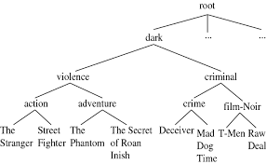
Conceptual Bias Useful for Defining Concepts
Assumption:
The conceptual bias is given for each attribute which is represented as a concept tree.
Such a concept tree is specified using an IS-A hierarchy and stored in a relation table, the concept hierarchy table.

Slide 21
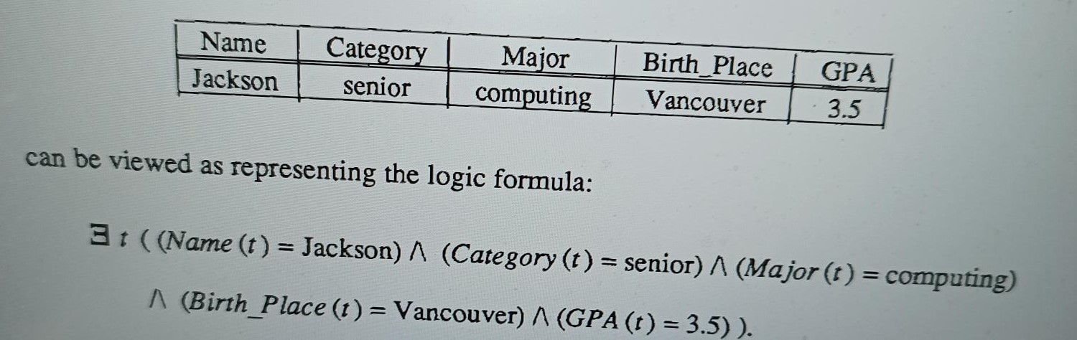
Language Used to Phrase Definition
We employ First-order predicate calculus
The intermediate and final learning results can also be represented using relational tables.
Definition: A generalized relation is a relation obtained by substituting the specific concept(s) by the general concept(s) in some attribute(s)
The maximum number of tuples in a final generalized relation, can be specified by users as a threshold value of the learning process.

Slide 22
Two Types of Rules
Characteristic rules and Classification rules can be learned
Characteristic rules
Definition: A characteristic rule is an assertion which characterizes the concepts satisfied by all of the data stored in the database.
Example: For example, the symptoms of a specific disease can be summarized as a characteristic rule.
Classification rules
Definition: A classification rule is an assertion which discriminates the concepts of one class from other classes.
Distinguish one disease from others, a classification rule should summarize the symptoms that discriminate this disease from others.
A characteristic rule provides generalized concepts about a property which can help people recognize the common features of the data in a class.
The classification rule gives a discriminant criterion which can be used to predict the class membership of new data.

Slide 23
The characteristic rules only concern the characteristics of the data.
Positive examples alone are enough to furnish the learning task.
For learning classification rules, the negative examples must be incorporated into the learning process to derive the concepts which have the discriminant property
For example, the data about students may be classified into graduate students and undergraduate students based on the value of the attribute "Category".
About target class and contrasting class.
Definition: A target class is a class in which the data are tuples in the database consistent with the learning concepts.
Definition: A contrasting class is a class in which the data do not belong to the target class.
For instance, to distinguish graduate students from undergraduate students, the class of graduate students is the target class, and the class of undergraduate students is the contrasting class

Slide 24
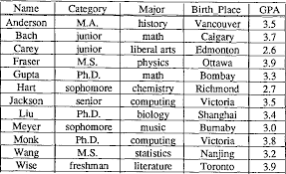
Example
A relation Student in a sample university database

Slide 25
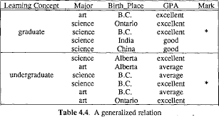

Slide 26
Concept Hierarchy C
Relationship between the values in category and "graduates" should be consulted in order to extract the relevant set of data.
We then examine C, the conceptual bias. Consider the following C, where A c B indicates that B is a"generalization" of A.
{ computing, math, biology, chemistry, statistics,physics } c science ( music, history, liberal arts, literature ) c art { freshman, sophomore, junior, senior ) c undergraduate M.S., M.A., Ph.D. ) c graduate ( Bumaby, Richmond, Vancouver, Victoria ) c British Columbia { Calgary, Edmonton ) c Alberta { Ottawa, Toronto ) c Ontario ( Bombay } c India [ Shanghai, Nanjing ) c China ( China, India ) c Foreign [ British Columbia, Alberta, Ontario ) c Canada { 2.0 - 2.9 ) c average [ 3.0 -3.4 ) c good ( 3.5 - 4.0 } c excellent

Slide 27
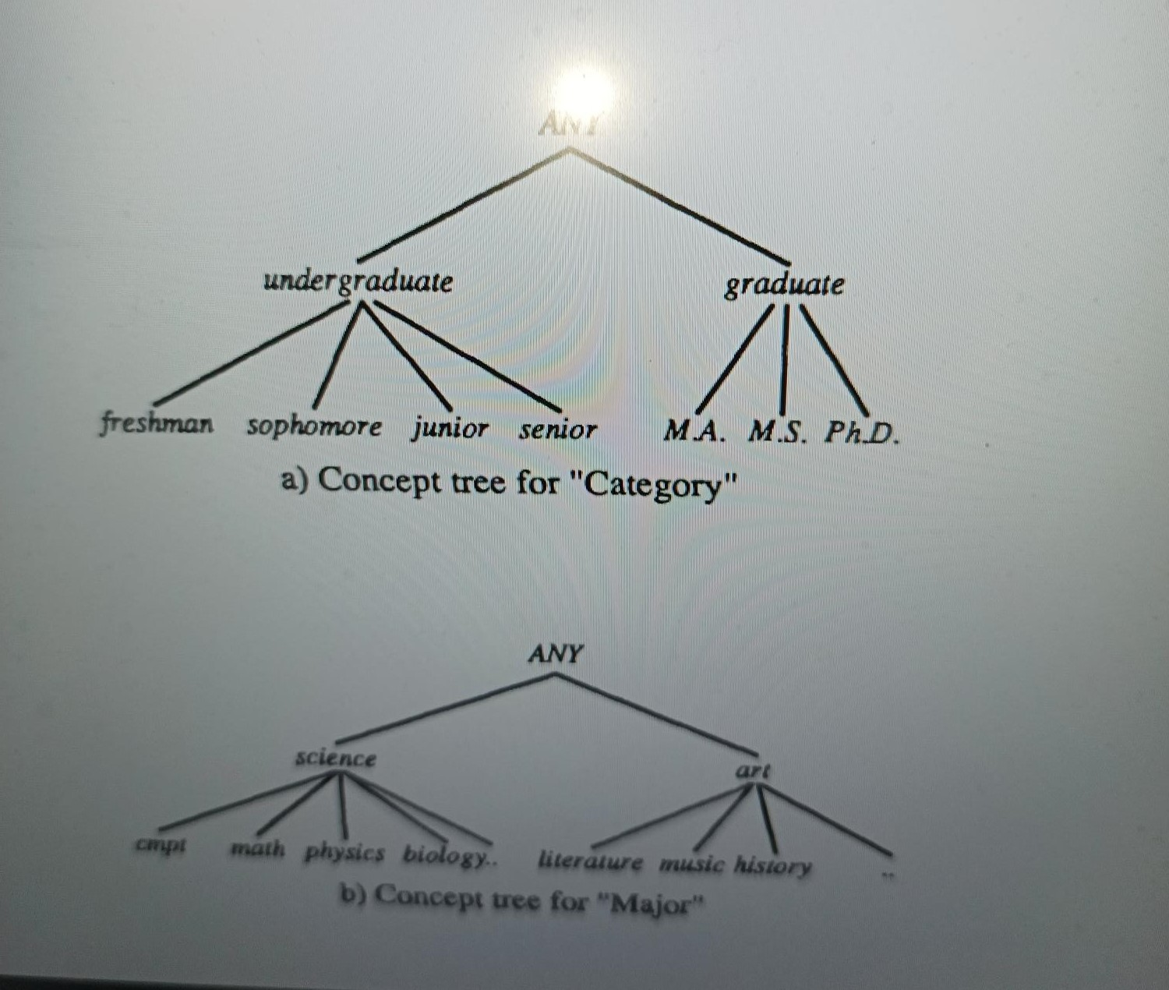
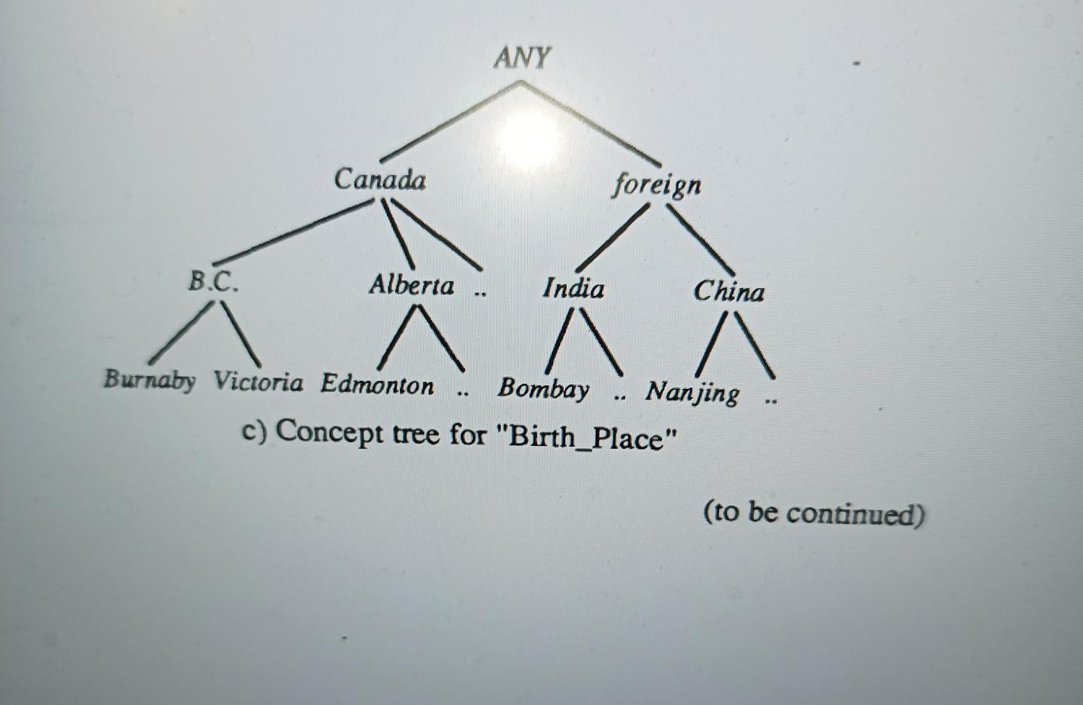
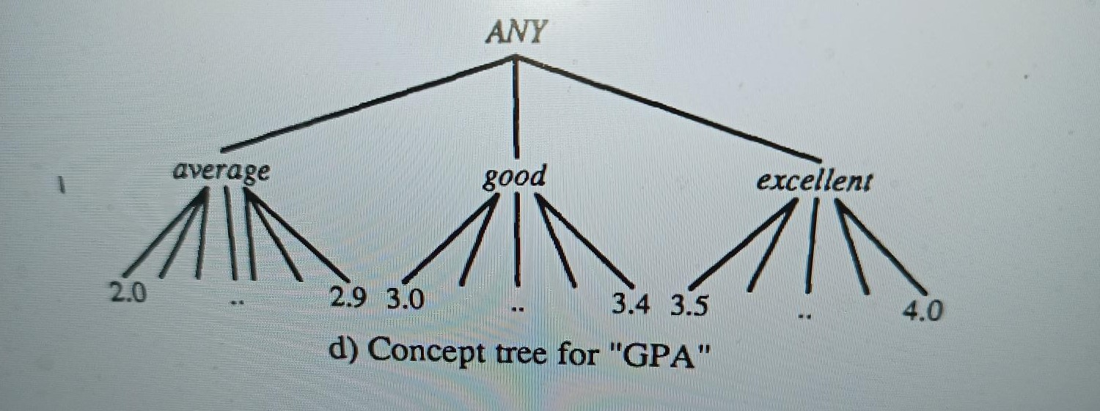

Slide 28
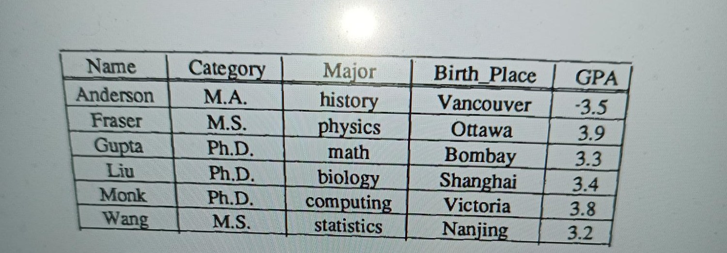

The set of data relevant to "graduates

Slide 29
Outline
Introduction
Learning from examples (Related Work)
Concepts of learning from databases
Attribute oriented induction in relational databases
Variations of the learning algorithms
Discussion
Implementation and experiments
Conclusions and future research

Slide 30
Two algorithms: the LCHR algorithm and the LCLR algorithm
Learning Characteristic Rules
Generalization Strategy 1 (Attribute Removal)
If there is a large set of distinct values for an attribute but there is no higher level concept provided for the attribute, the attribute should be removed during generalization.
Example: Name is the key of the relation and represents a large set of values so it should be removed.
Generalize to ALL or NULL
Generalization Strategy 2. (Generalization on the smallest decomposable components)
Generalization should be performed on the smallest decomposable components of a data relation.
Least commitment principle
Commitment to minimally generalized concepts
By generalizing lease decomposable attributes, we may discover interesting information about that components.

Slide 31
Two algorithms: the LCHR algorithm and the LCLR algorithm
Learning Characteristic Rules
Generalization Strategy 3. (Ascending the concept tree)
If there are many distinct values for an attribute and there exists a higher level concept in the concept tree for the attribute, each value in the attribute of the relation should be substituted by a higher level concept in the learning process
Generalization Strategy 4. (Threshold control)
If the number of distinct values in a resulting relation is larger than the specified threshold value, further generalization on this attribute should be performed

Slide 32
Algorithm 4. LCHR -Learning characteristic rules from relational databases.
Input: (i) a relational database,(ii) a concept hierarchy table,(iii) the learning task, and (iv) the threshold value (T).
Output: A characteristic rule for the target class learned from the database
Step 1. Select the task-relevant data relation P.
Step 2. Perform attribute-oriented induction, which is described by the following procedure
Generalization is performed on each attribute of P.
Step 3: Simplify the generalized relation
If only one attribute of several tuples contains distinct values, the several tuples can be reduced into one by taking the distinct values of that attribute as a set.
Step 4: Transform the final relation into logic formulas

Slide 33
Learning Classification Rule
Similar to the LCHR algorithm, the LCLR algorithms also applies the attribute-oriented induction technique.
The difference is that in the extraction of classification rules, the facts which support the target class serve as positive examples, while the facts which support the other classes serve as negative examples.
Since the learning task is to discover the concepts that have discriminant properties, the portion of facts in the target class that overlaps with other classes should be detected and removed from the description of classification rules

Slide 34
Overlapping rules
Overlapping tuples Definition: A set of overlapping tuples is a set of tuples which are shared by different classes.
Generalization Strategy 5. (Handling overlapping tuples)
If there are overlapping tuples in both target and contrasting classes, these tuples should be marked and eliminated from the final generalized relation

Slide 35
LCLR -Learning classification rules from relational database
Input: (i) a relational database,(ii) a concept hierarchy table,(iii) the learning task, and (iv) the threshold value (T).
Output: A classification rule for the target class learned from the database
Step 1. Select the task-relevant data of the target class and the contrasting class to form relation P and cluster the data by classes.
Step 2. Perform attribute-oriented induction, which is described by the following procedure
Generalization is performed on each attribute Ai of each class.
Perform intersection of both classes and mark the overlapping tuples;
Step 3: Remove the overlapping tuples
Step 4: Transform the final relation into logic formula

Slide 36
Outline
Introduction
Learning from examples (Related Work)
Concepts of learning from databases
Attribute oriented induction in relational databases
Variations of the learning algorithms
Discussion
Implementation and experiments
Conclusions and future research

Slide 37
Variations of the algorithms
Adjusting Thresholds for Different Learning Results
The output vary based on the thresholds
Dealing with Different Kinds of Concept Hierarchies
Balanced and imbalanced concept hierarchies
Generalization of Concepts in the Hierarchies with Lattice
Incorporating Quantitative Information
Addition of attribute “votes”, how many tuples have contributed to this rule?
Handling Noisy Data and Exceptional Cases

Slide 38
DISCUSSION
Limitations
Assumption:
availability of concept hierarchy data
Applicable on only formatted data

Slide 39
Experiments
Refer research paper

Slide 40
Conclusion and Future work
Conclusion
Our analysis of the algorithms demonstrates that the attribute-oriented induction approach substantially reduces the complexity of the database learning process.
Future Work
Applications of Knowledge Rules Discovered from Relational Database
Discovery of knowledge rules for knowledge-base systems and expert systems
Processing of queries which involve abstract concepts.
Semantic query optimization using the learned rules
Construction of an Interactive Learning System
Discovery of Concept Hierarchies

